Slide 1




Ad-Hoc Insights
Consumer Goods
Created & Presented By Sayan Maitra

Slide 2
Today's agenda
01
04
Introduction
About data
02
05
Objective
Ad-hoc Requests and Tools
03
06
Overview of Company
Ad-hoc Requests Findings: Results, Visualizations, and Insights

Slide 3
Introduction
Atliq Hardwares (Abstract entity) is one of the leading computer hardware producers in India and well expanded in other countries too.
The management has observed a deficiency in obtaining sufficient insights for prompt and informed decision-making.
They want to grow the data analytics team with junior analysts.
Tony Sharma, their data analytics director, is looking for people good at both tech and soft skills.
To find the right fit, he plans to hold a SQL challenge to test candidates' technical and communication skills.

Slide 4
Objective
Address and provide insights for 10 ad hoc requests presented by the management team.
Empower the management team with data-driven decision-making.
Deepen understanding of the business landscape.
Facilitate informed and impactful decisions.
Support the company's scalability objectives.

Slide 5
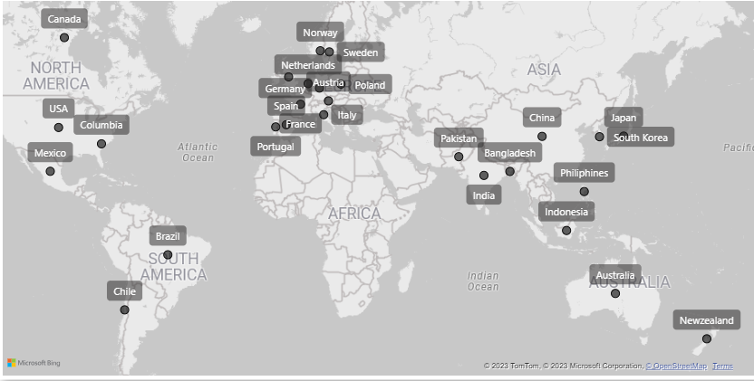
Overview of Company
Atliq Hardware is a global player in computer hardware and accessories, operating in 27 countries.
The company manufactures products under three major divisions:
Peripherals & Accessories
PC
Networking & Storage
Atliq Hardware utilizes three primary channels/platforms for sales:
Retailer
Distributor
Direct
Global Presence: Atliq Hardware's Operational Markets
The company's fiscal year spans from September to August annually.

Slide 6
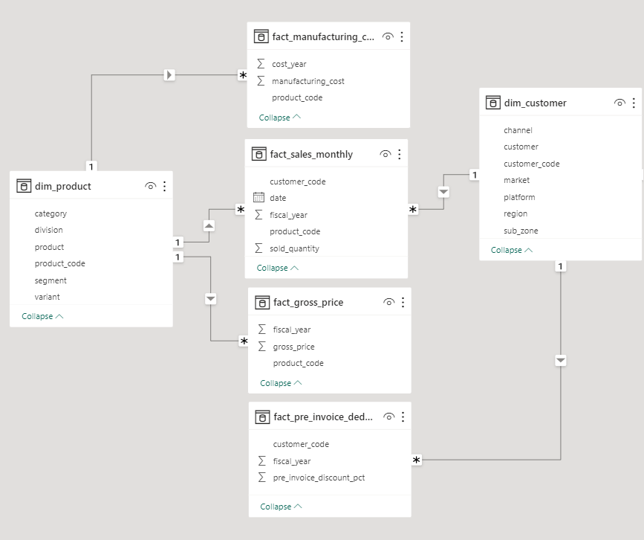
About data
Atliq Hardware's data structure comprises four fact tables, namely: sales monthly, manufacturing cost, pre-invoice deductions, and gross price. Additionally, there are two dimension tables, one for customer details and another for product details.
We have sales data for two fiscal years: 2020 and 2021.

Slide 7
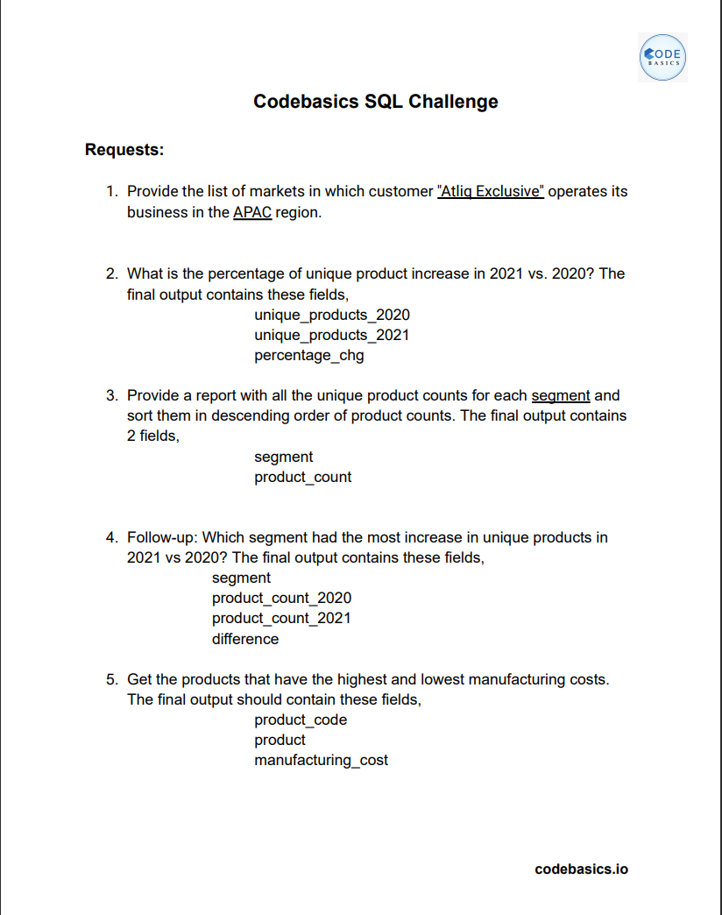
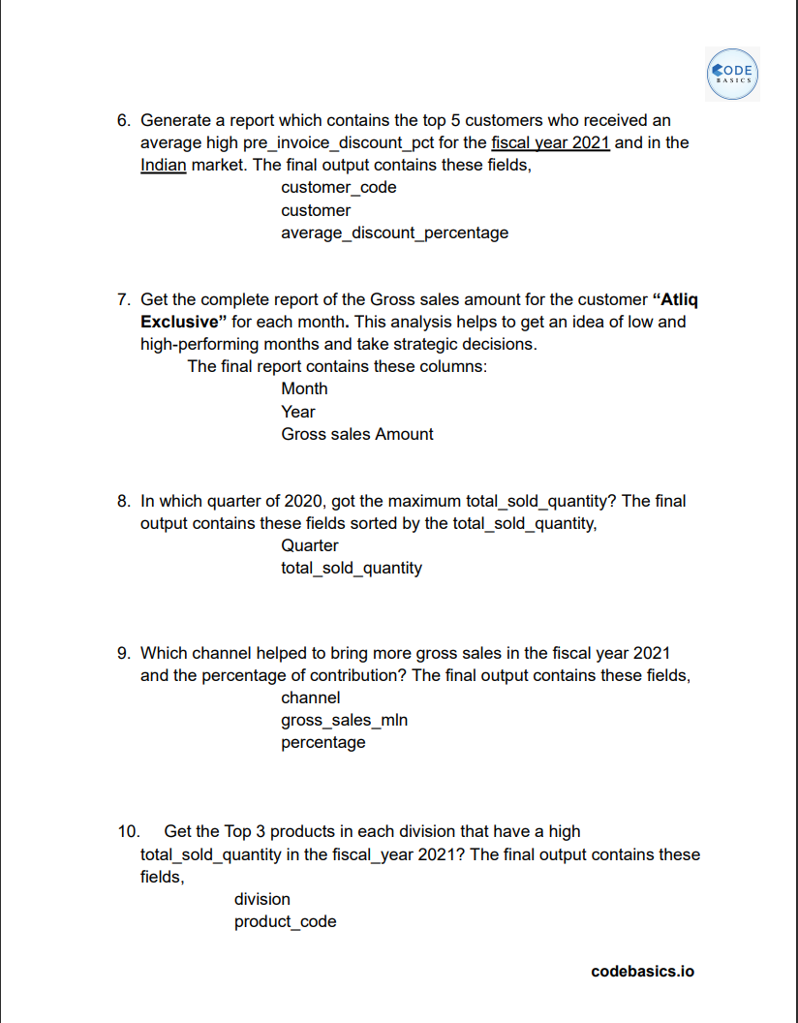



Ad-hoc Requests and Tools
Ad-hoc Requests
Tools Stack
&

Slide 8

Ad-hoc Requests Findings: Results, Visualizations, and Insights

Slide 9
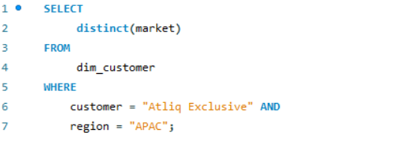
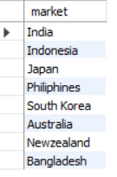
Request 1:
Provide the list of markets in which customer "Atliq Exclusive" operates its business in the APAC region.
Query
Result

Slide 10
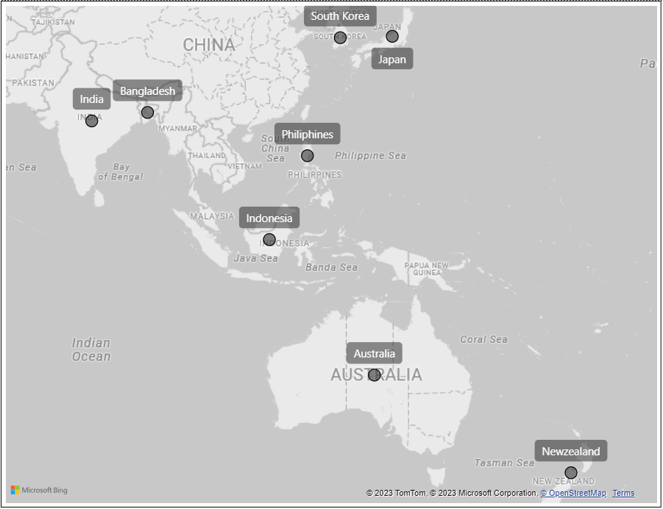
Insights
Atliq Exclusive has the most stores in APAC(8) region followed by 6 in EU and 2 in NA.
Atliq Exclusive’s Operational Markets in APAC Region

Slide 11
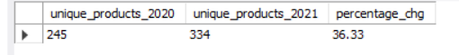
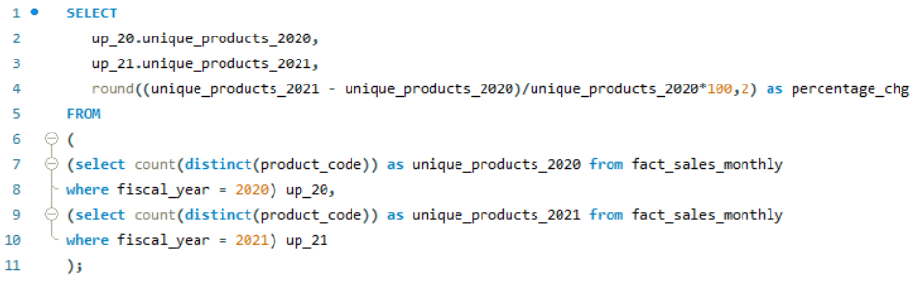

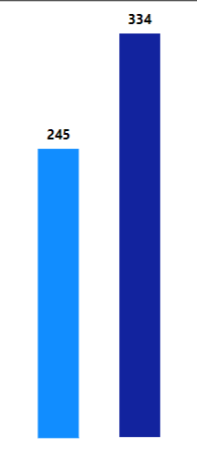
Request 2:
What is the percentage of unique product increase in 2021 vs. 2020? The final output contains these fields: unique_products_2020, unique_products_2021, percentage_chg.
Result
Query
Insight
Altiq hardware is earning a strong reputation by meeting changing customer needs, with a notable 36.33% increase in new products.

Slide 12
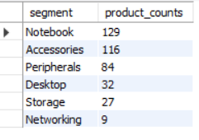
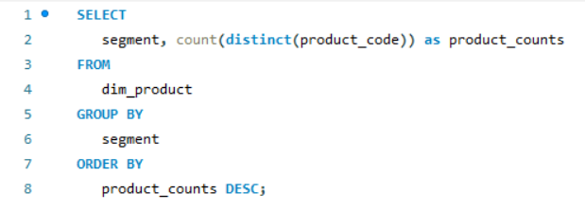
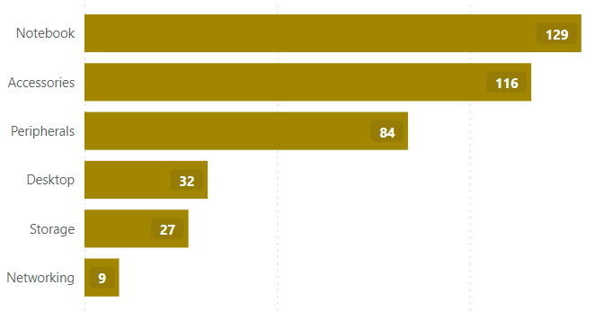
Request 3:
Provide a report with all the unique product counts for each segment and sort them in descending order of product counts. The final output contains 2 fields, segment product_count.
Result
Query
Insights
With a diverse product portfolio, Altiq Hardware excels in the Notebook, Accessories, and Peripherals segments, showcasing an average of 110 products. However, the Desktop, Storage, and Network segments lag behind, with an average of 23 products per segment.
To enhance the product offerings, a strategic initiative involves refining Desktop, Storage, and Network products in alignment with current market preferences. This commitment to contemporary standards positions Atliq Hardware as an innovative leader in the industry.
Unique product counts for each segment

Slide 13
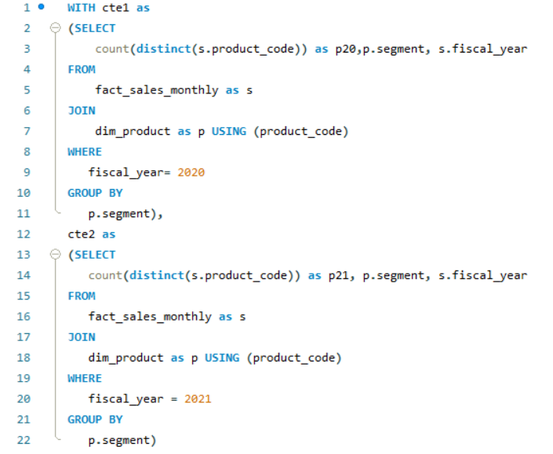
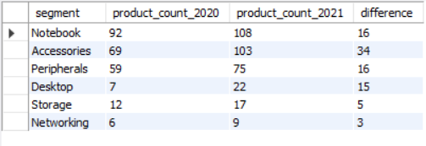
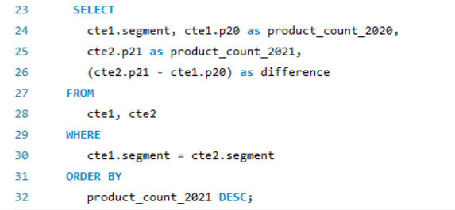
Request 4:
Follow-up: Which segment had the most increase in unique products in 2021 vs 2020? The final output contains these fields, segment ,product_count_2020, product_count_2021, difference.
Query
Result

Slide 14
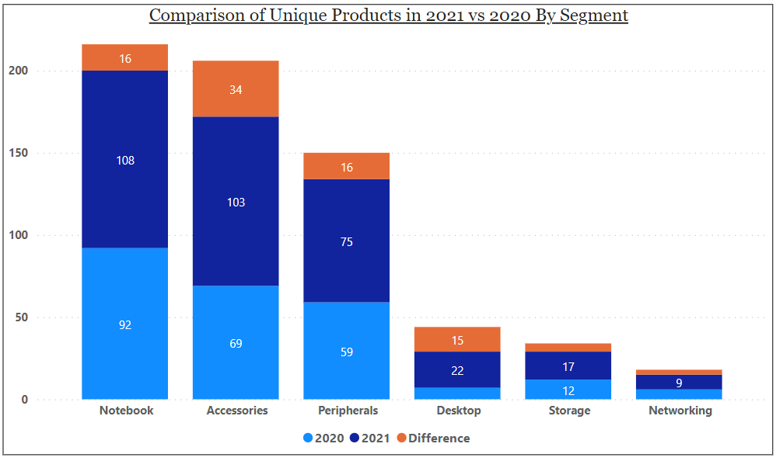
Insights
The Accessories segment leads with the introduction of 34 new products, reflecting the highest increase in the number of unique offerings.
Notebooks and Peripherals each show a commendable increment of 16 new unique products.
The Product Development team excels in the Desktop segment, elevating unique products from 7 to 22.
The Networking segment lags behind, introducing only 3 new products.

Slide 15
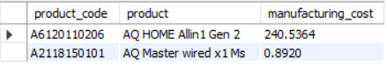
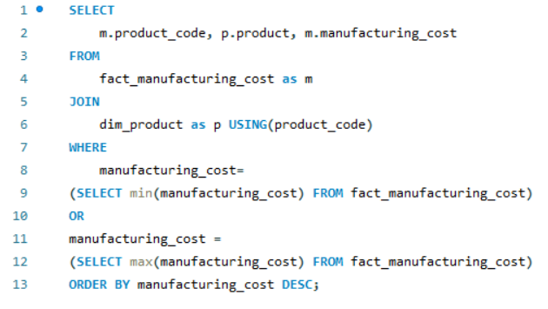
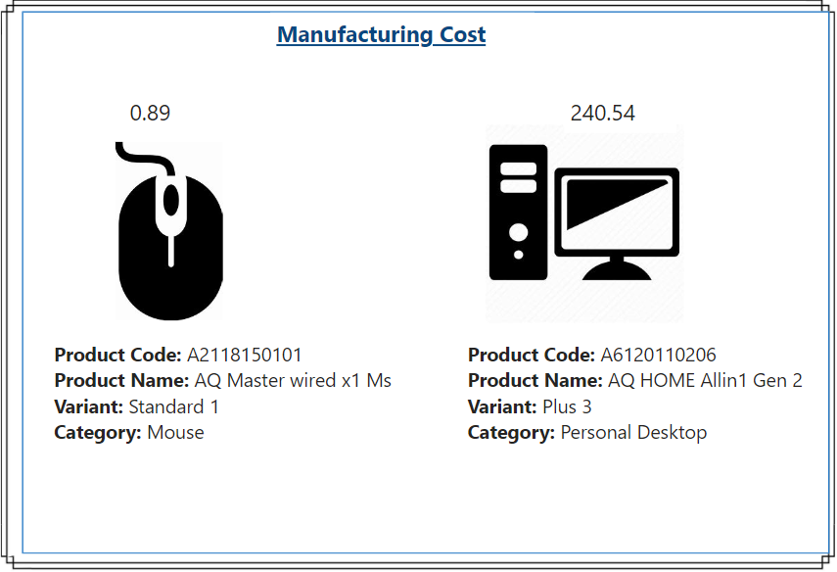
Request 5:
Get the products that have the highest and lowest manufacturing costs. The final output should contain these fields: product_code, product, manufacturing_cost.
Result
$
$
Query

Slide 16
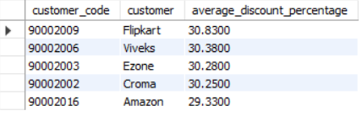
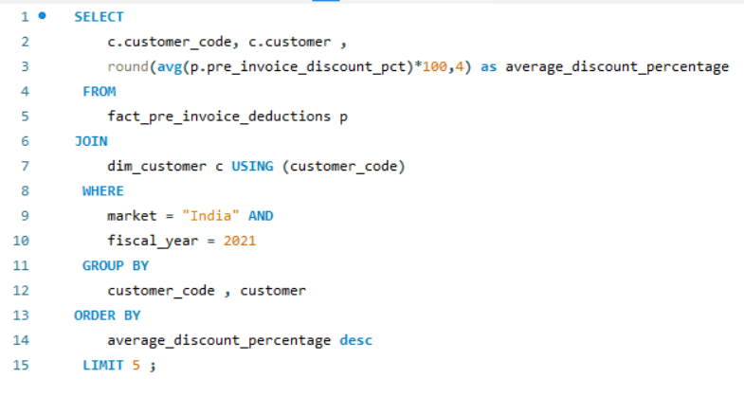
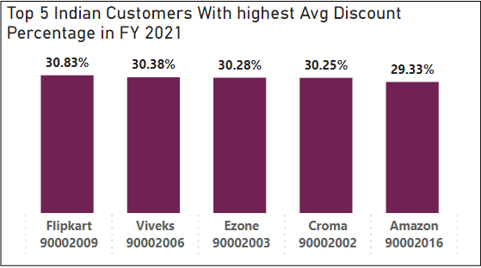
Request 6:
Generate a report which contains the top 5 customers who received an average high pre_invoice_discount _pct for the fiscal year 2021 and in the Indian market. The final output contains these fields: customer_code, customer, average_discount_percentage.
Result
Query
Insight
The highest avg discount was extended to Flipkart, marking it as the most discounted customer with a percentage of 30.83%. In the fiscal year 2021, a nearly equal Avg discount percentage was offered to each of our top 5 customers.

Slide 17
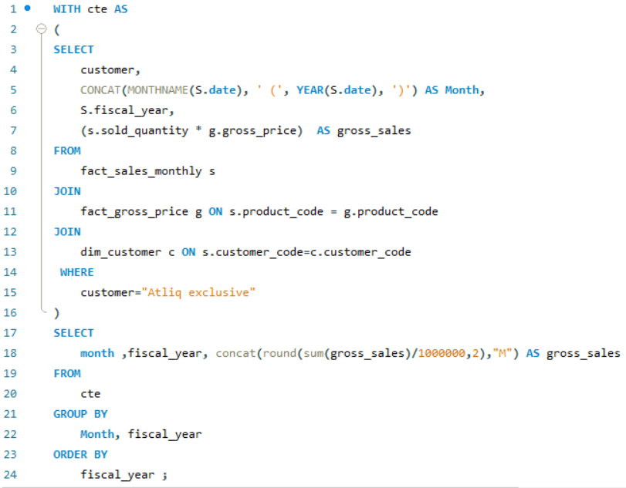
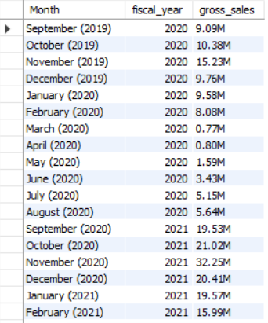
Request 7:
Get the complete report of the Gross sales amount for the customer “Atliq Exclusive” for each month. This analysis helps to get an idea of low and high-performing months and take strategic decisions. The final report contains these columns: Month, Year, Gross sales Amount.
Result
Query

Slide 18
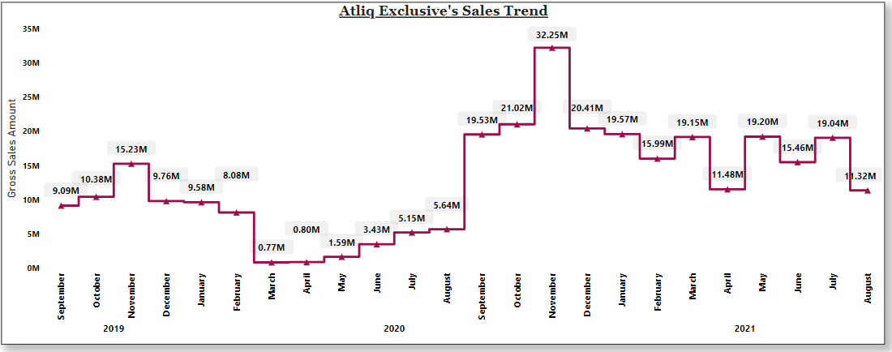
FY 2020
FY 2021
Insights
Atliq Exclusive Store recorded its highest sales in November 2020, reaching $32.25 million.
The lowest sales were observed in March 2020, totaling $0.77 million.
The dip in sales from March to August is attributed to the impact of the COVID-19 pandemic and temporary store closures.
A positive shift occurred from September 2020 onward, driven by the easing of lockdown restrictions.

Slide 19
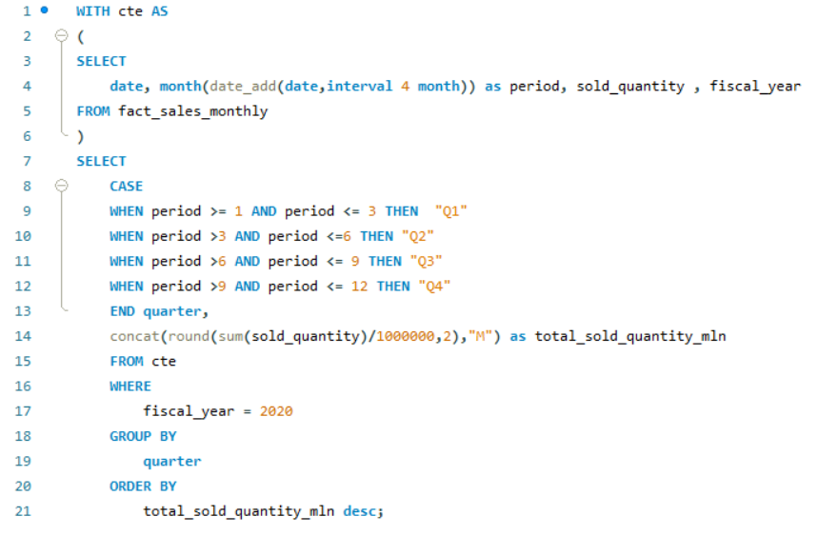
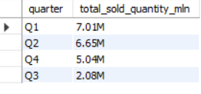
Request 8:
In which quarter of 2020, got the maximum total_sold_quantity? The final output contains these fields sorted by the total_sold_quantity, Quarter total_sold_quantity.
Result
Query

Slide 20
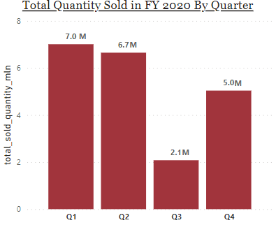
Insights
FY 2020 saw the highest quantity sold during Q1 (September-November), reflecting strong performance.
Q3 (March-May) witnessed a decline in sales due to the impact of the pandemic.
During Q4 (June-August), a noteworthy increase in sales was observed, signaling a positive recovery trend. This surge was influenced by a growing demand for electronic goods during that period, highlighting its probable correlation with the uptick in sales.

Slide 21
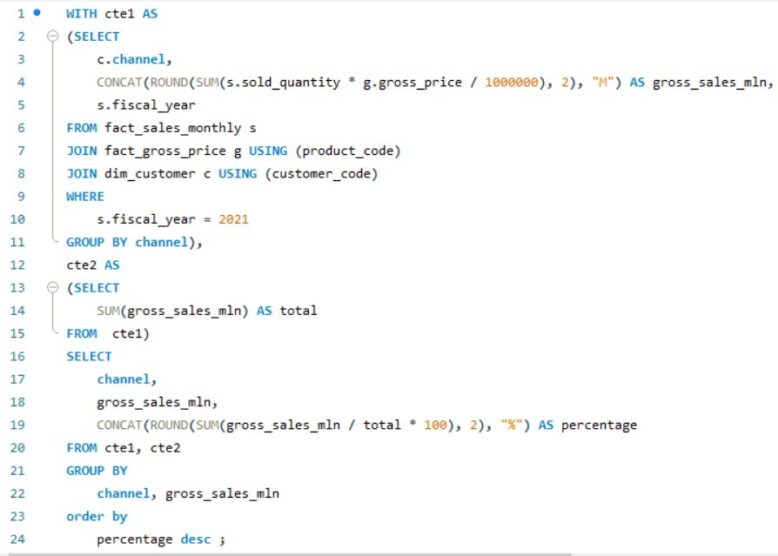
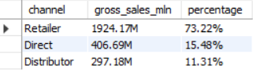
Request 9:
Which channel helped to bring more gross sales in the fiscal year 2021 and the percentage of contribution? The final output contains these fields: channel, gross_sales_mln, percentage.
Result
Query

Slide 22
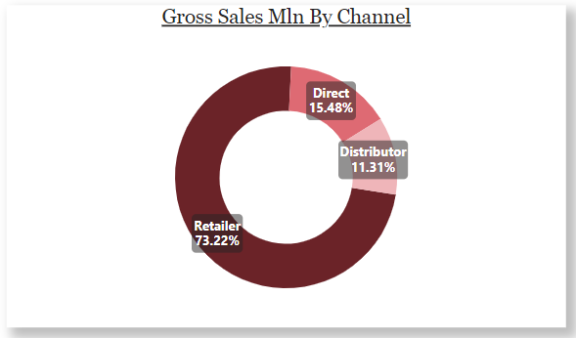
Insights
Retailers played a big part, bringing in $1924.17 million, which is 73.22% of our total sales in FY 2021.
Direct channels followed, contributing $406.69 million.
Distributors had the smallest contribution, with $297.18 million.

Slide 23
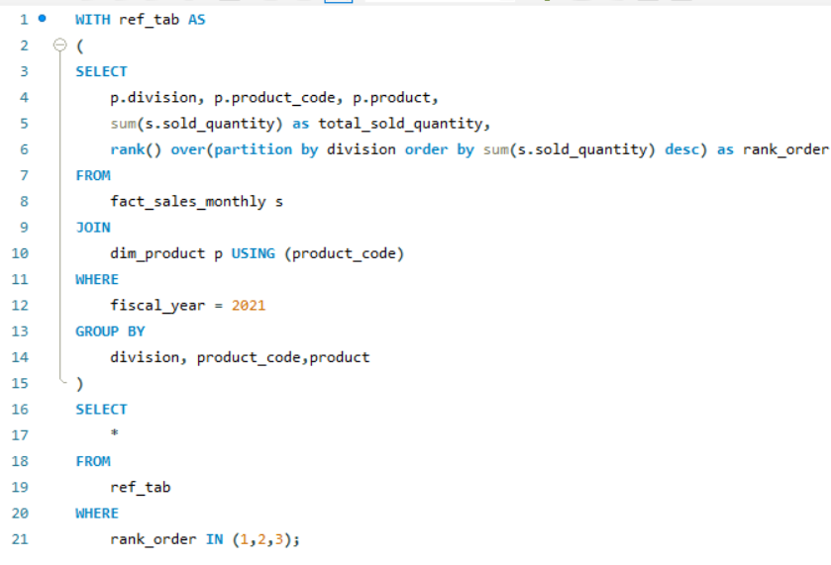
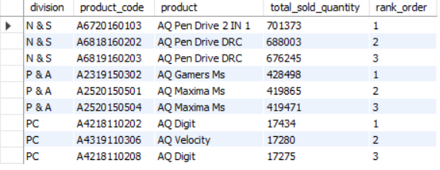
Request 10:
Get the Top 3 products in each division that have a high total_sold_quantity in the fiscal_year 2021? The final output contains these fields: division product_code, product, total_sold_quantity, rank_order.
Result
Query

Slide 24
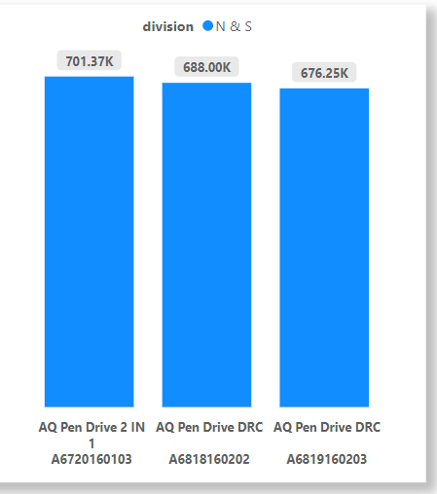
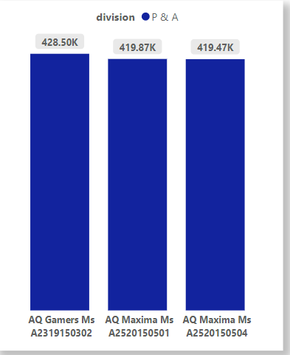
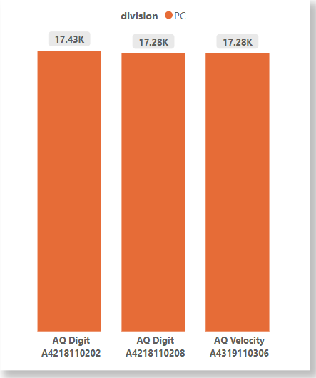
Top 3 Selling Products in each Division in FY 2021
Insights
In N&S division, the top 3 selling products were pen drives with various variants, totaling around 7 lakh in quantity.
For P&A division, mouse with different variants took the lead as the top 3 selling products, amounting to around 4 lakh in quantity.
However, in the PC division, personal laptops were the top-selling products, but the quantity was relatively lower, standing at around 17,000.
PC division's sales lag behind other divisions; implementing strategic decisions to enhance the quantity and competitiveness of personal laptops is crucial for improvement.

Slide 25
Thank you

